Slide 1
Ornela N. Dehayem, Ryan F. A. Brewer, Luis Valente, Frederic Lens, Rampal S. Etienne. 2025. “Impact of sampling strategy on inference of community assembly processes in phylogenetic island biogeography”. Methods in Ecology and Evolution. 16:1507–1520. https://doi.org/10.1111/2041-210X.70058
Class focus area: Simulation
EEB603: Brian O’Meara
All quotes and images from the above paper unless otherwise noted

Slide 2
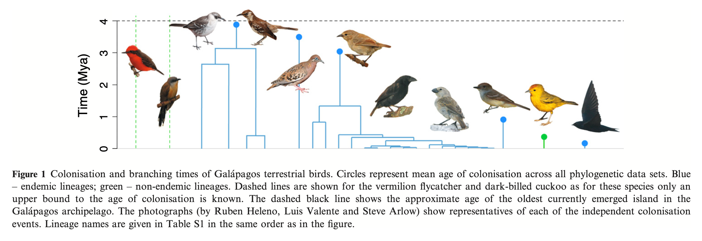
Luis M. Valente, Albert B. Phillimore and Rampal S. Etienne 2015

Slide 3
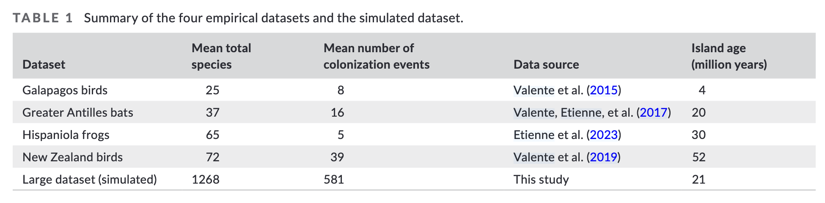

Slide 4
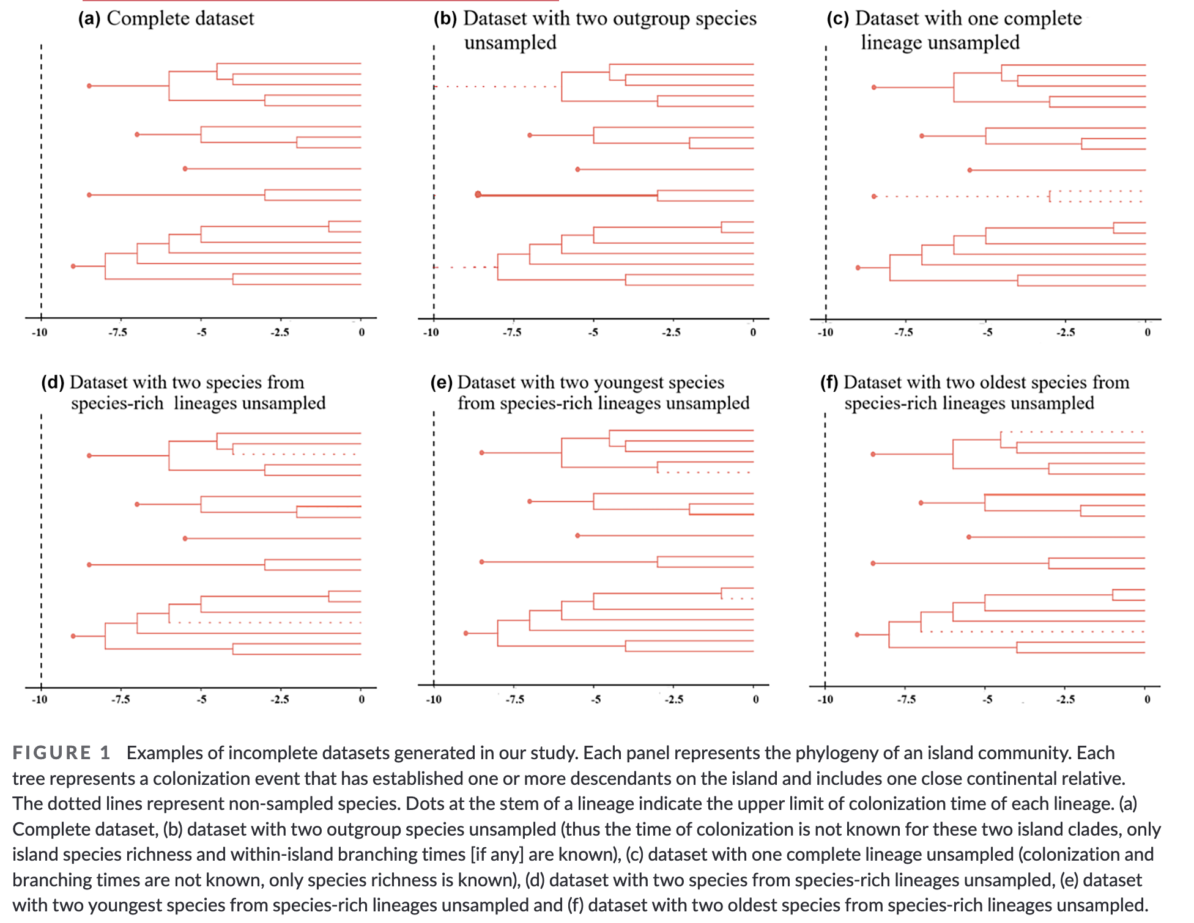

Slide 5
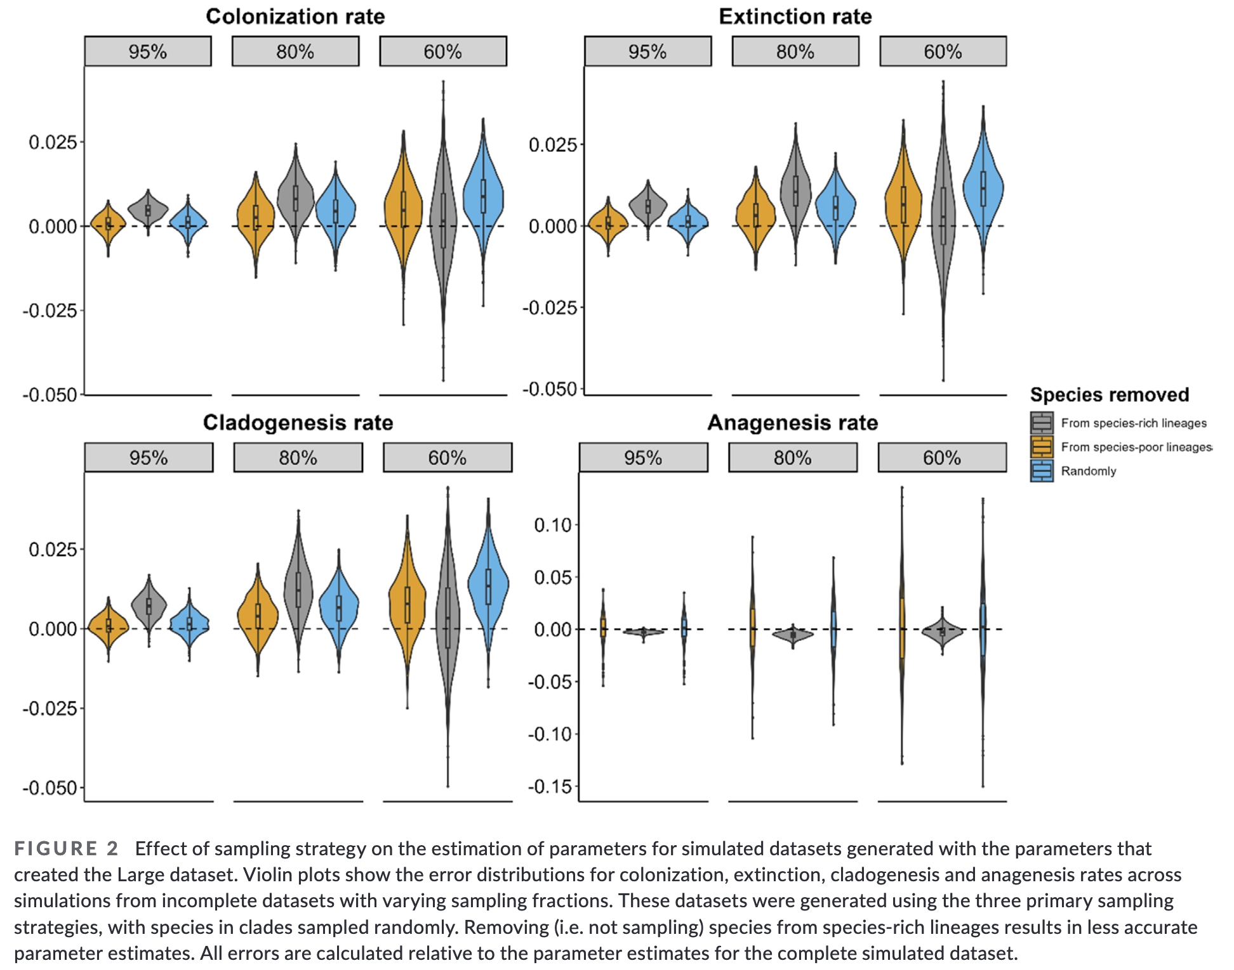

Slide 6
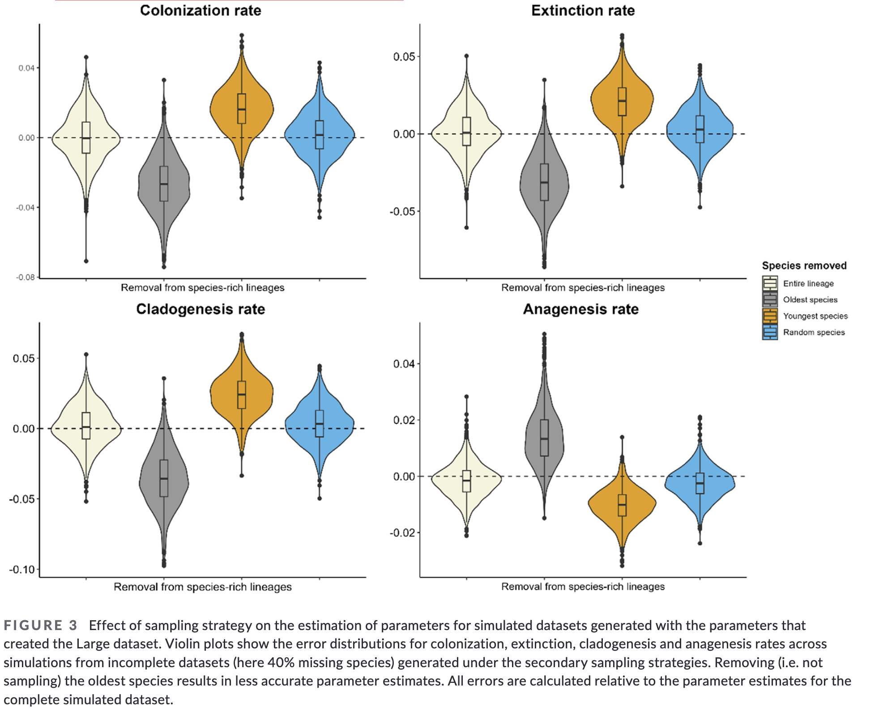

Slide 7
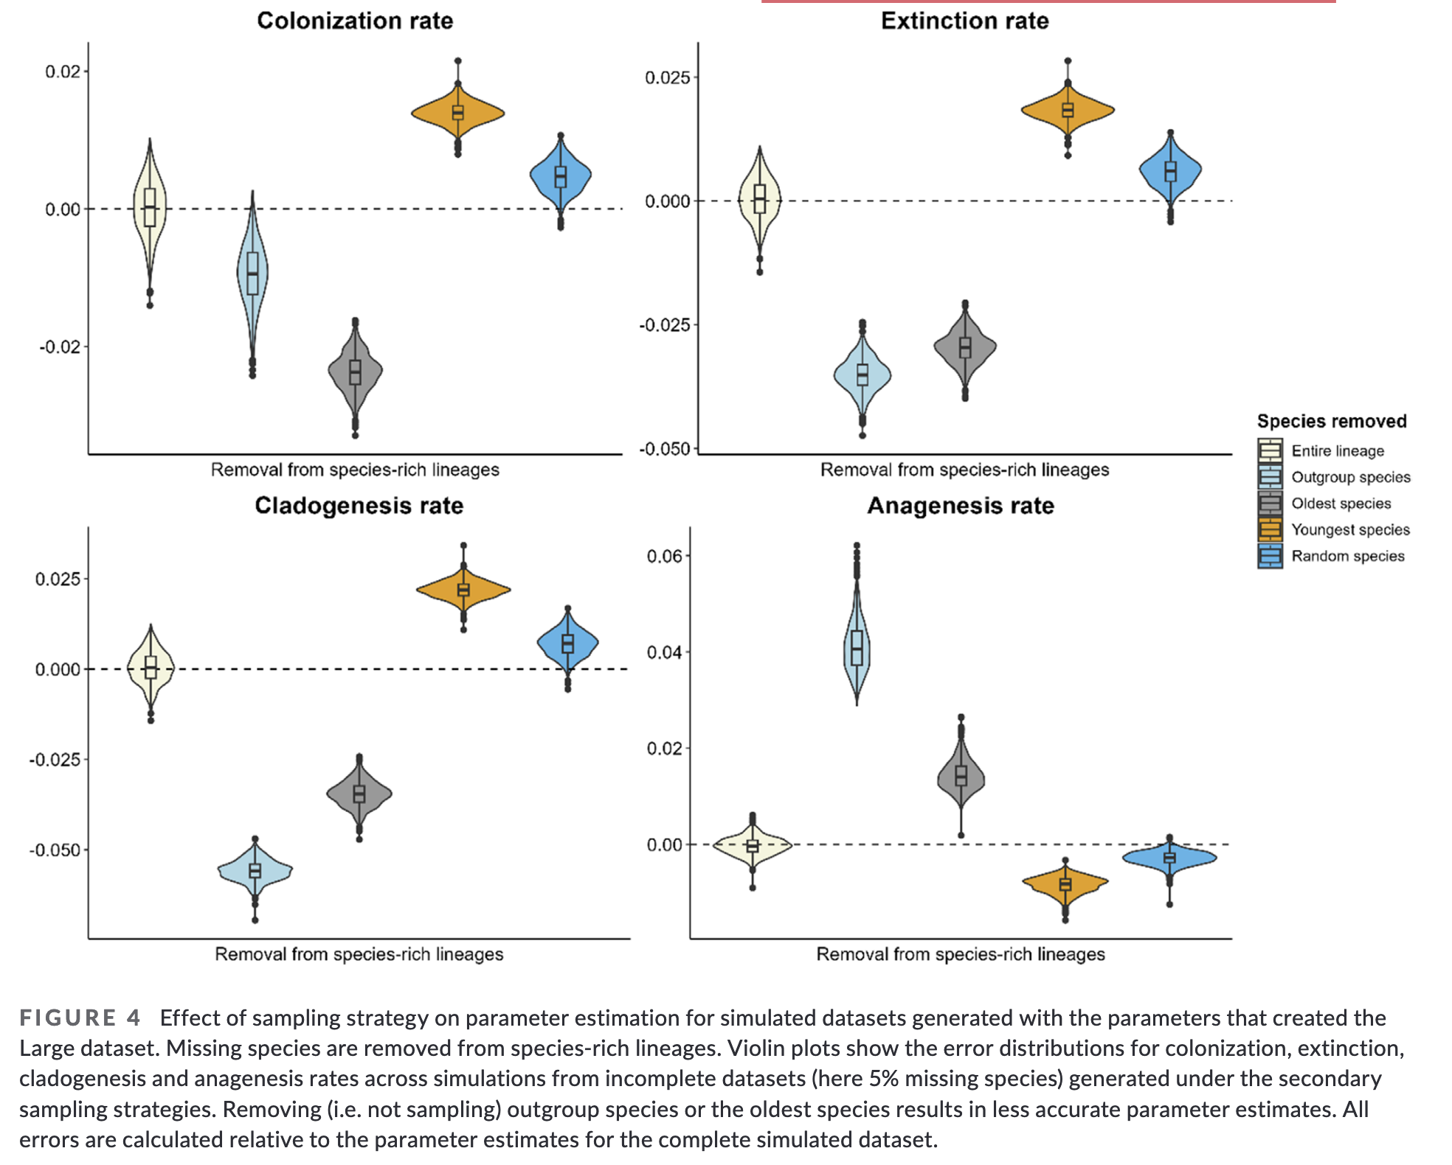

Slide 8
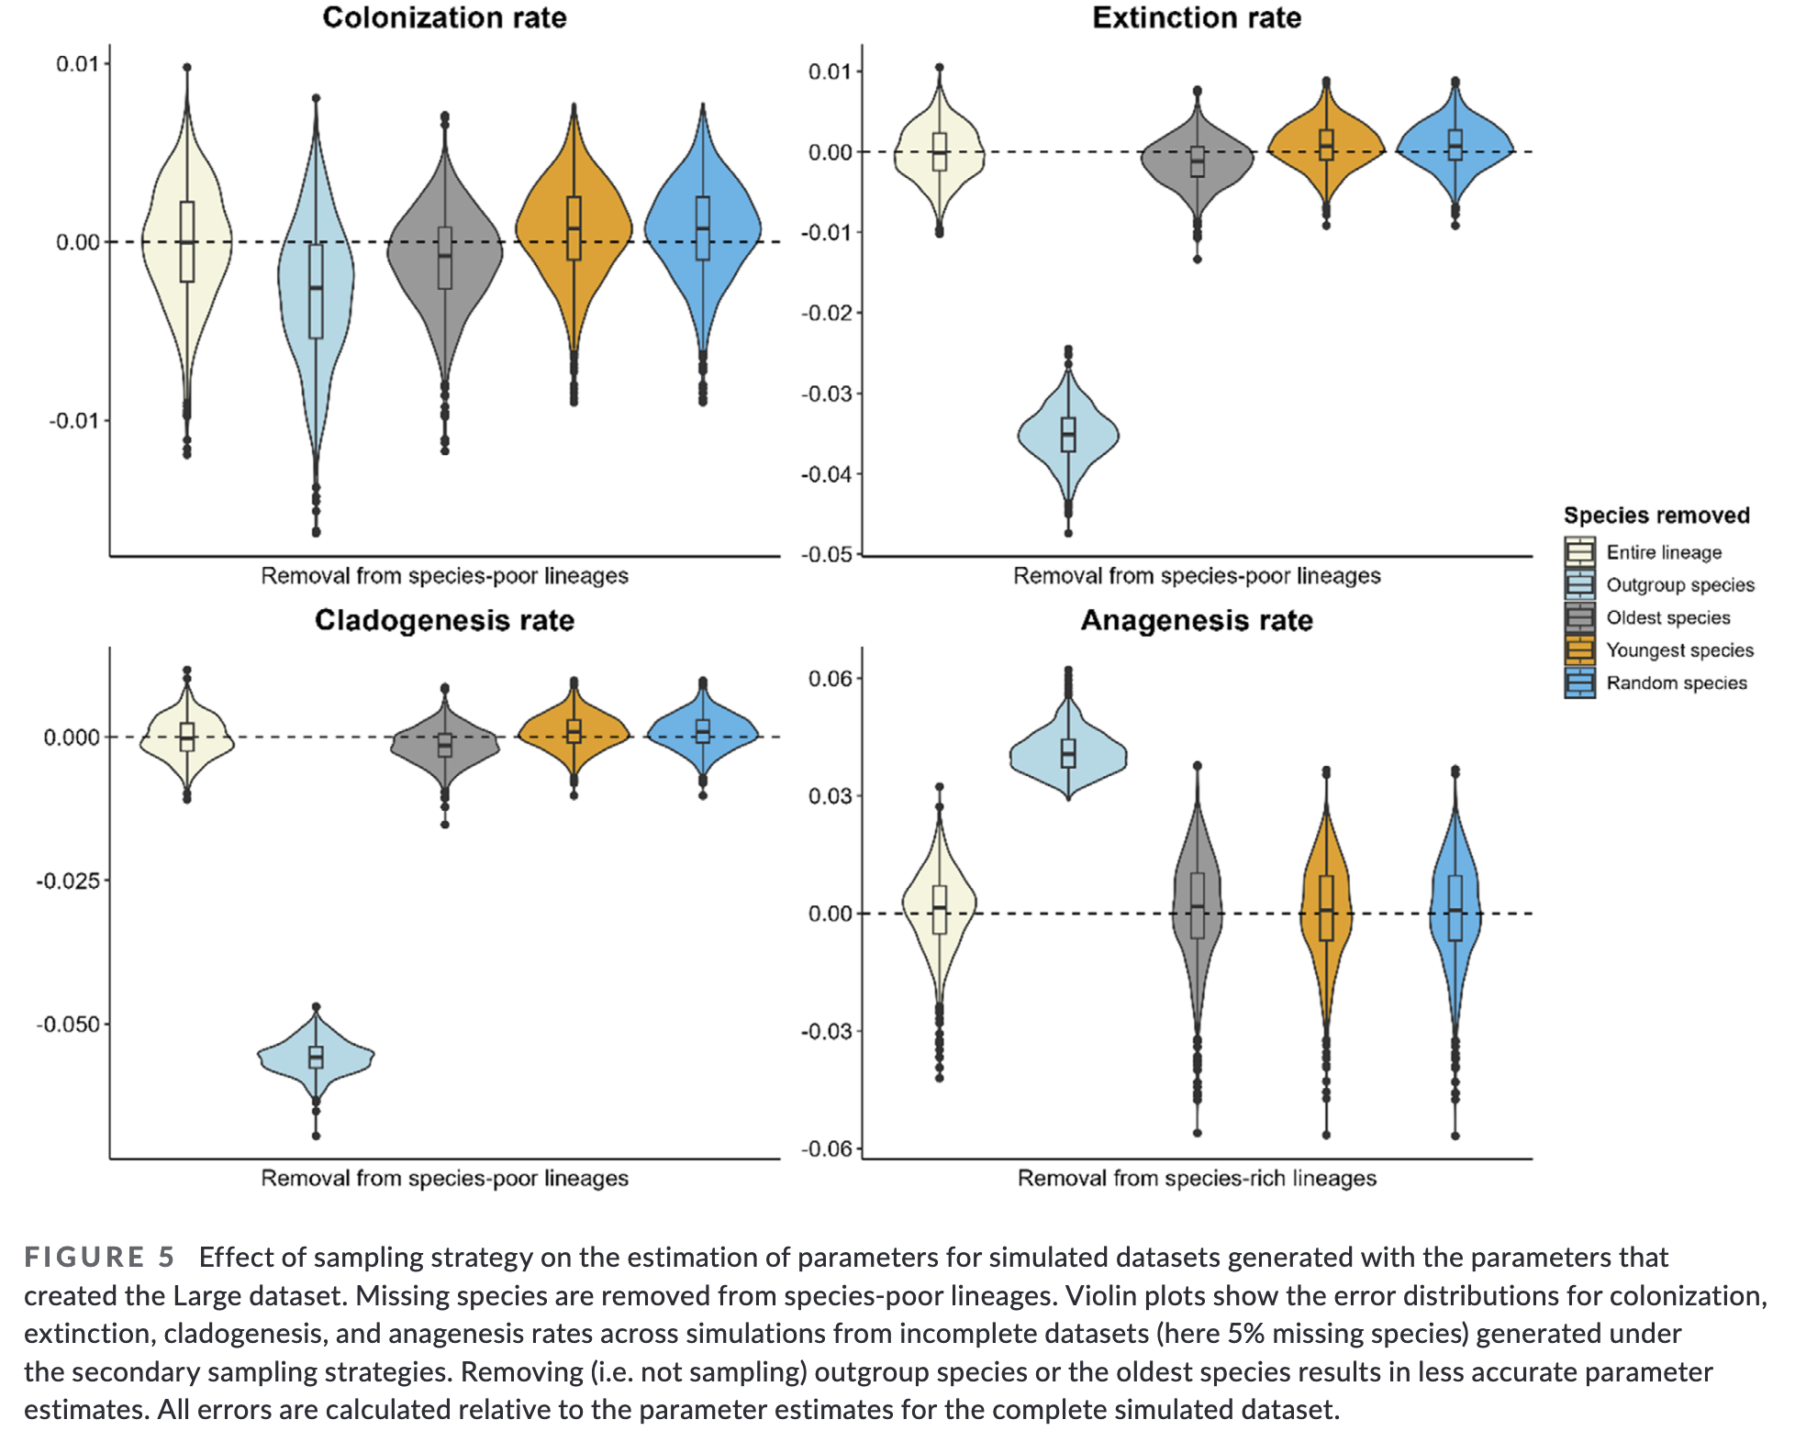

Slide 9
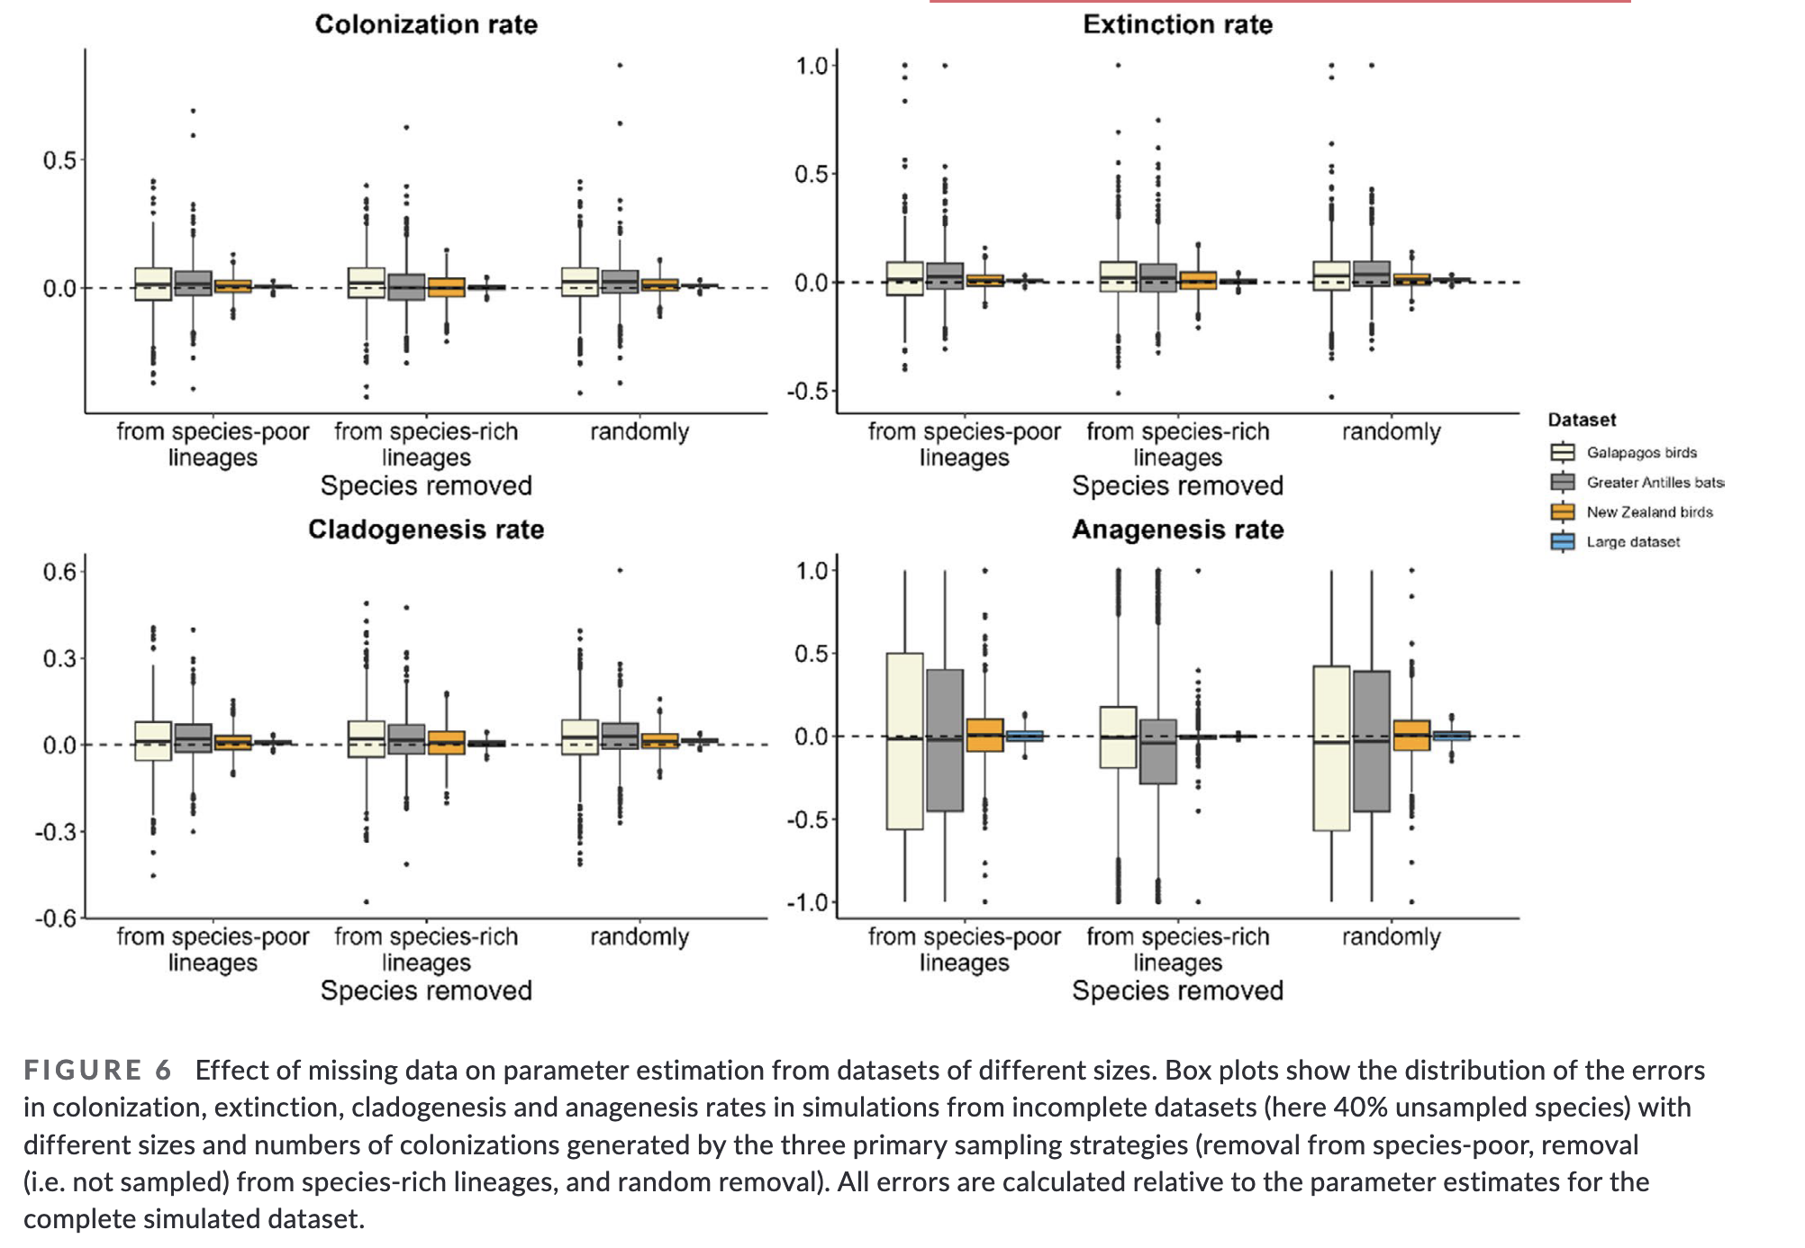

Slide 10
Do species have ages?
Does it matter that this paper and the DAISIE paper have some of the same authors?
Could this be done if the generating model were not a DAISIE model?
Does statistical significance matter for a simulation study?
How do you simulate a tree?

